Slide 1

Welcome to Highfield
St Matthew’s Nursery
New intake meeting

Slide 2
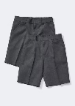



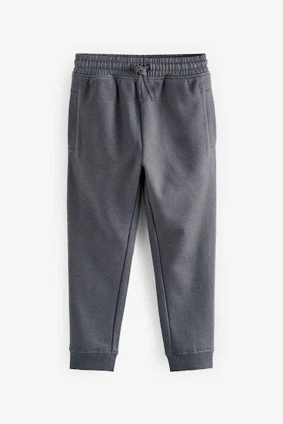



What will my child need to wear to nursery?

Slide 3
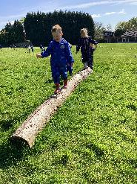
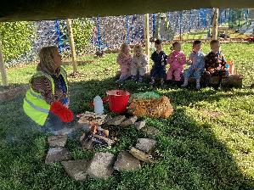
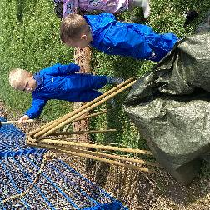



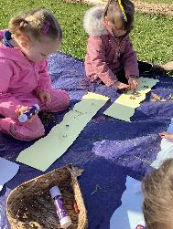
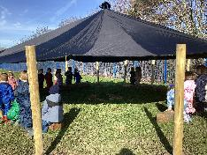



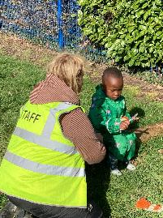
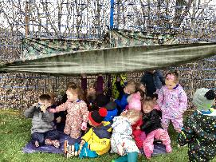
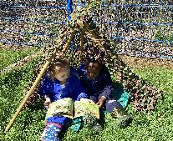


Forest School
What they will need

Slide 4


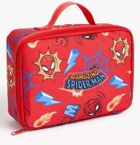


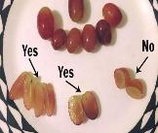



Lunch time and Snack times
Packed Lunches
Evolve for school dinners –
Information how to set up is your packs
Snacks- Out in morning and water out all day
No need to send anything into school .

Slide 5

Session Times
9.00am- 3.00pm (Full Days)
Wednesdays half day 9.00am- 12pm and 12pm-3pm
Lunchtimes are 11.30am until 12.10pm
Drop off and pick up from nursery door (Side entrance please don’t use staff carpark)
Attendance, please inform us.

Slide 6
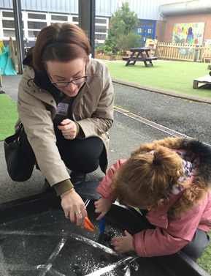
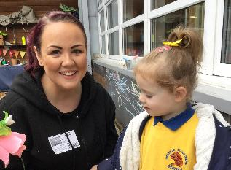
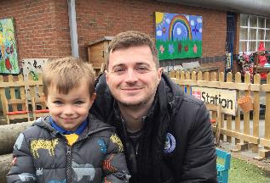

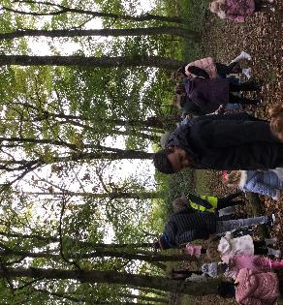
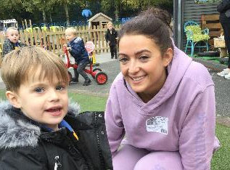
Working together to support your child.
Tapestry
Parents Evening x2 a year Autumn and Spring and a Yearly Report
Weekly homework
Newsletter
Paperless/Cashless School
(Teacher to Parents )

Slide 7
What Next?
Home Visits – Thursday 25th June and Monday 29th June. Can make an appointment this evening.
Play stay – Tuesday 7th July 1.30pm-2.30pm
Taster Days- From Thur 3rd Sept
Full time- Week beginning Sept 7th

Slide 8


