Slide 1
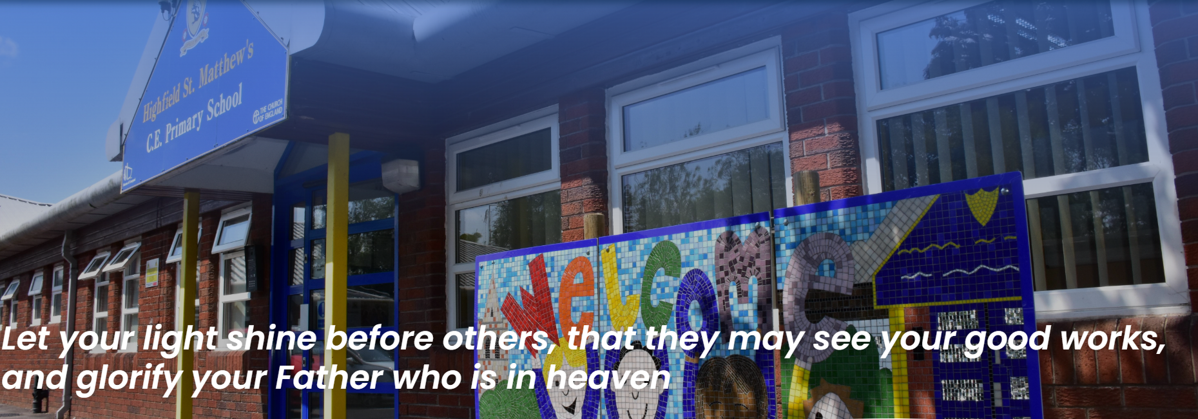

Slide 2

Welcome
Early Years Foundation Stage Staff
RECEPTION:
Reception Teachers – Miss Canning and Mrs Saunders
EYFS Lead – Mrs Saunders
NURSERY:
Nursery Teacher – Mrs Chatterley
Teaching Assistant – Mrs Cockroft

Slide 3



Slide 4

Independence and Resilience
Moving to Reception is a huge step for young children. A priority throughout the school is to develop independence and resilience starting in the early years
We understand that it is a big step for parents too. You are leaving your child with new adults and children, in a new and huge environment.
They were upset when I left. I hope they don’t cry all day!
Who will help them if they are upset?
What if they need the toilet?
Will they be happy and make friends?
Will they go thirsty or be able to get a regular drink?
Will they be warm, clean and dry?
What happens if we are late?
Will they cope with the work?

Slide 5

We will support you and your child to settle in quickly
Some examples of how we support:
  Transition days
  Drop off - We ask that you talk your child through the drop off procedure as you walk them around to the gate, so that they know what is expected of them
  Work towards leaving your child at the gate and not the classroom door. Children learn quickly how to come into Reception by themselves. They soon become independent and can take off and hang up their own coat, find their tray, put their water bottle in the box and start learning.
  We will use a visual timetable to break down the day with the children
  Reception staff on the gate to take messages, greet the children and support them with leaving their parents if needed.
  Staff available in the classroom and corridor to support children with their routine.

Slide 6
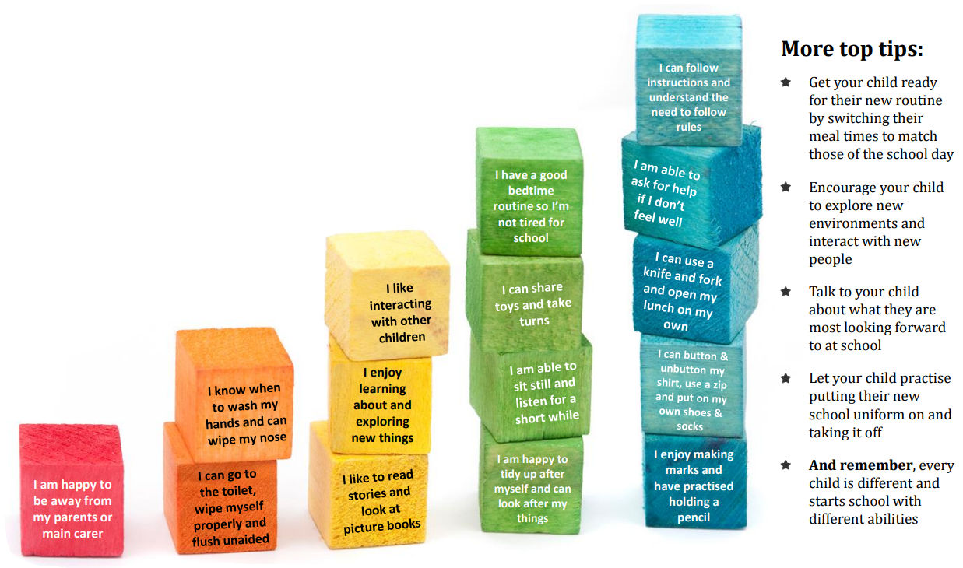

Slide 7
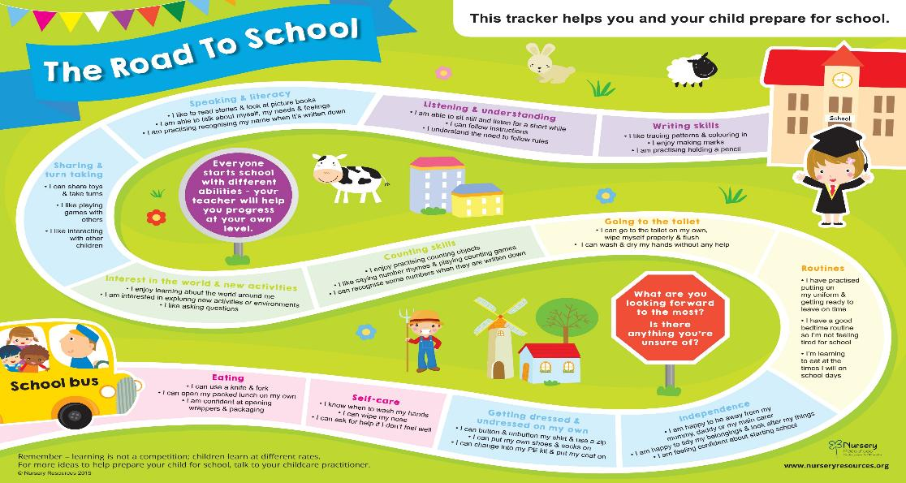
How can I help my child to be Reception Ready?

Slide 8
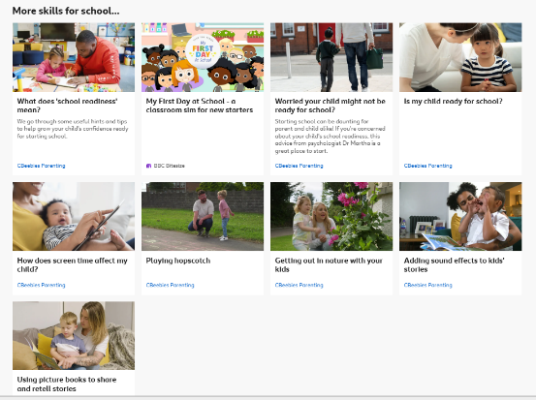
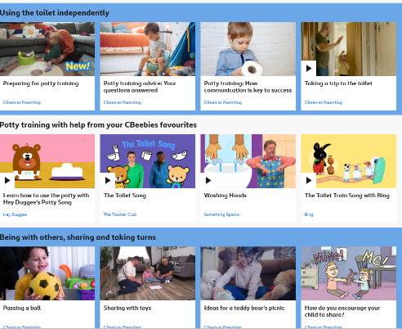
https://www.bbc.co.uk/tiny-happy-people/topics/cr4rez0de6vt

Slide 9






Communicating and working together with parents and Carers
Uniform
Water bottles
Snack - Fruit, milk or water
Lunch
Autumn Term – Meet the teacher, Parent’s evening
Reading at home and home school book (homework)
Communicating with parents/carers - Evolve, Teachers to Parents,
Tapestry and Classdojo
Social media platforms
Attendance and Safeguarding
Medicine

Slide 10


The Curriculum
Your child will be learning skills, acquiring new knowledge and demonstrating their understanding through 7 areas of learning. All areas are vital and interconnected.
The Prime Areas:
Personal, Social and Emotional Development
Communication and Language development
Physical Development
Specific Areas:
Literacy
Mathematics
Understanding the World
Expressive Arts and Design

Slide 11
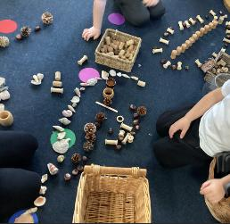
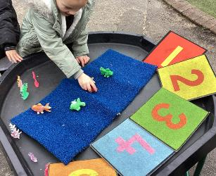
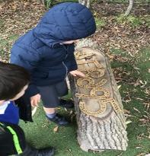
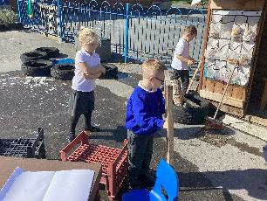
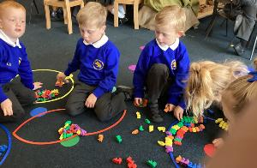
Teaching and Learning
The curriculum is play based both inside and outside
Children are assessed and activities are planned so that resources and enhancements provided in different areas of the indoor and outside classroom will support the learning needs or interests of your child
All areas of learning are interlinked and carefully planned through adult led focused activities or child led activities within carefully planned areas of continuous provision
We progress throughout the year to formal teaching of Phonics, Maths and English lessons.

Slide 12
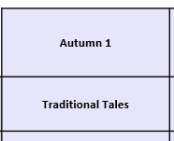
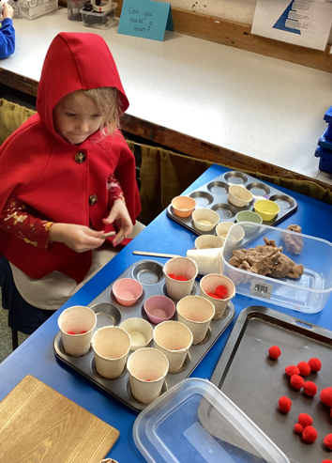
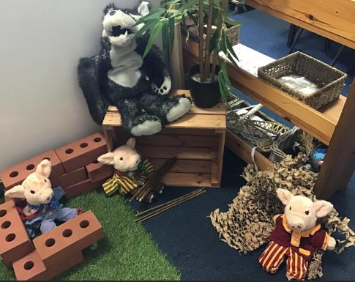
Our curriculum:

Slide 13
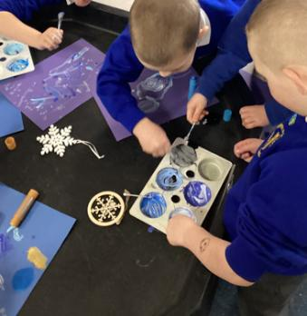
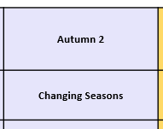
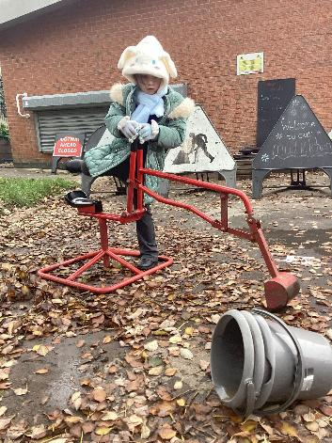
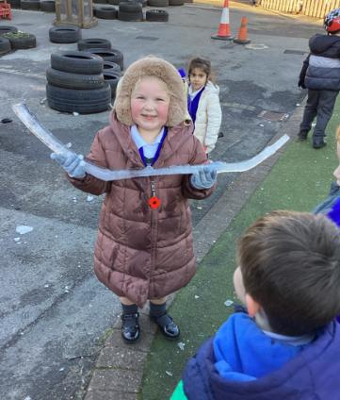
Our curriculum:

Slide 14
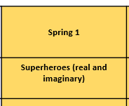
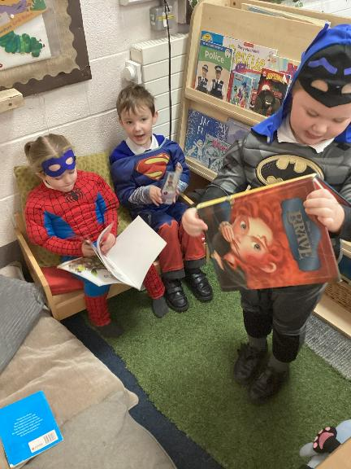
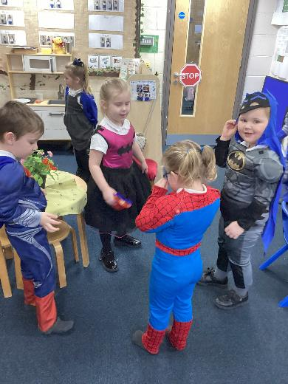
Our curriculum:

Slide 15
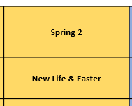
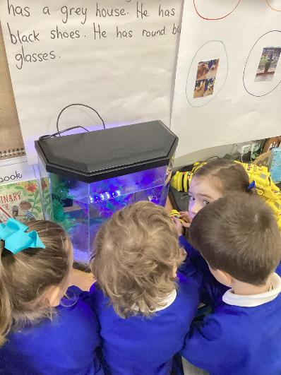
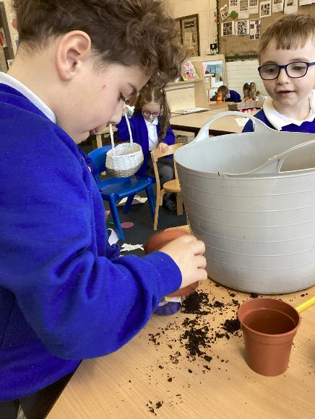
Our curriculum:

Slide 16
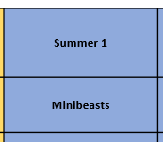
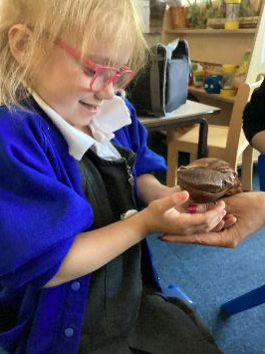
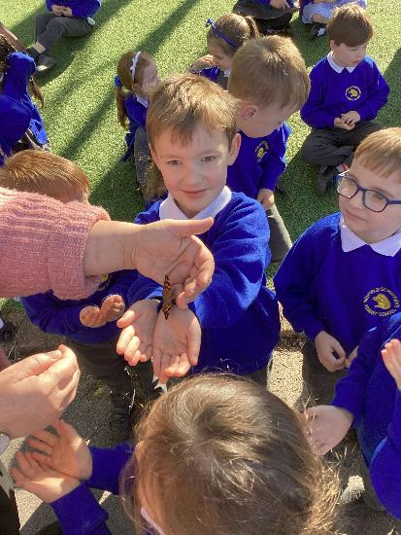
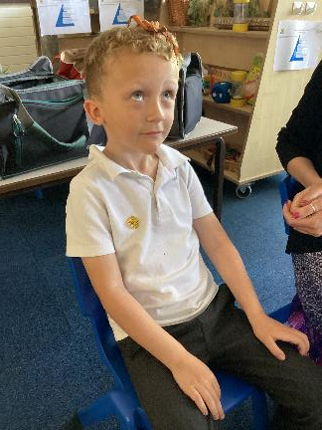
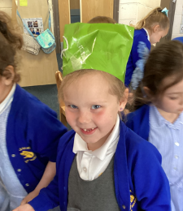
Our curriculum:

Slide 17
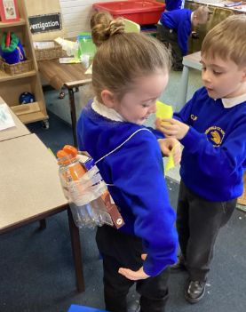
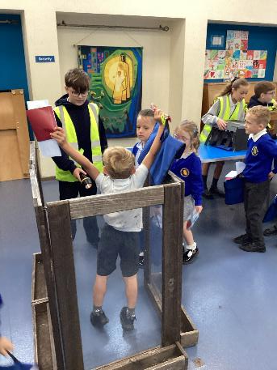
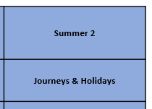
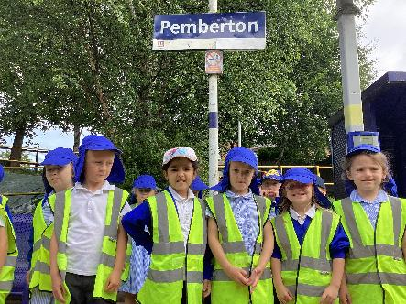
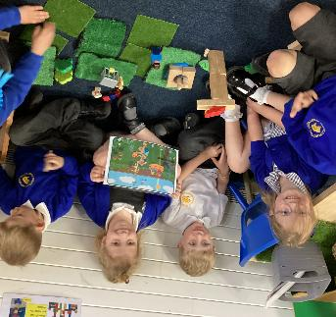
Our curriculum:

Slide 18
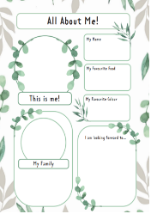
Transition
Stay and Play
Monday 6th July
1-1.45 Oak class, 2-2.45 Ash class
Transition days
Monday 13th July
Allocated a morning or afternoon
Tuesday 14th July
All day 8.40-3.15
Children need a packed lunch
Family photo

Slide 19
Next
Handouts and further information
‘School Readiness’ leaflets and ‘All About Me’
Monday 6th July – Stay and Play Session (return the ‘All About Me’ sheet and a family picture)
Oak class 1-1.45pm Ash class 2-2.45pm
transition sessions:
Monday 13th – morning or afternoon.
Tuesday 14th July – all day. Children need a packed lunch
– uniform samples, Trinity -Before and After School Club, food samples,
Tour of Classroom

